Slide 1
CCC831 2019
Session 1-3
Kothari ch. 10

Slide 2
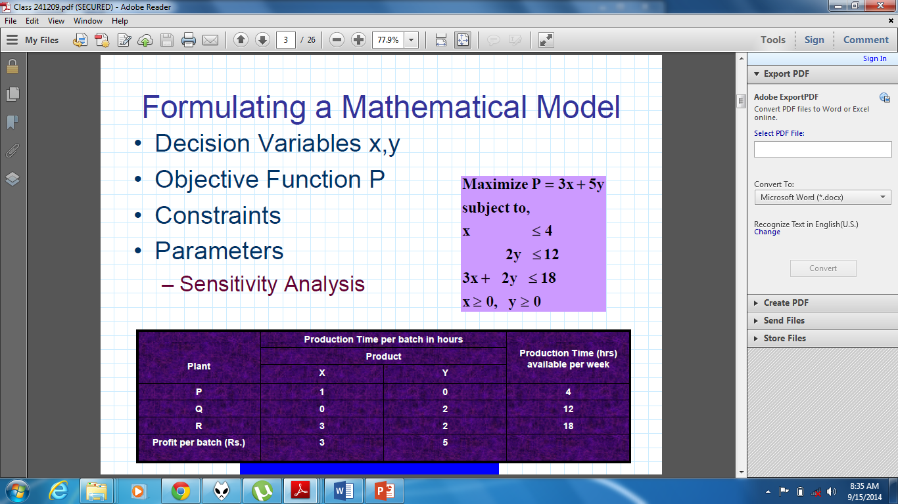

Slide 3
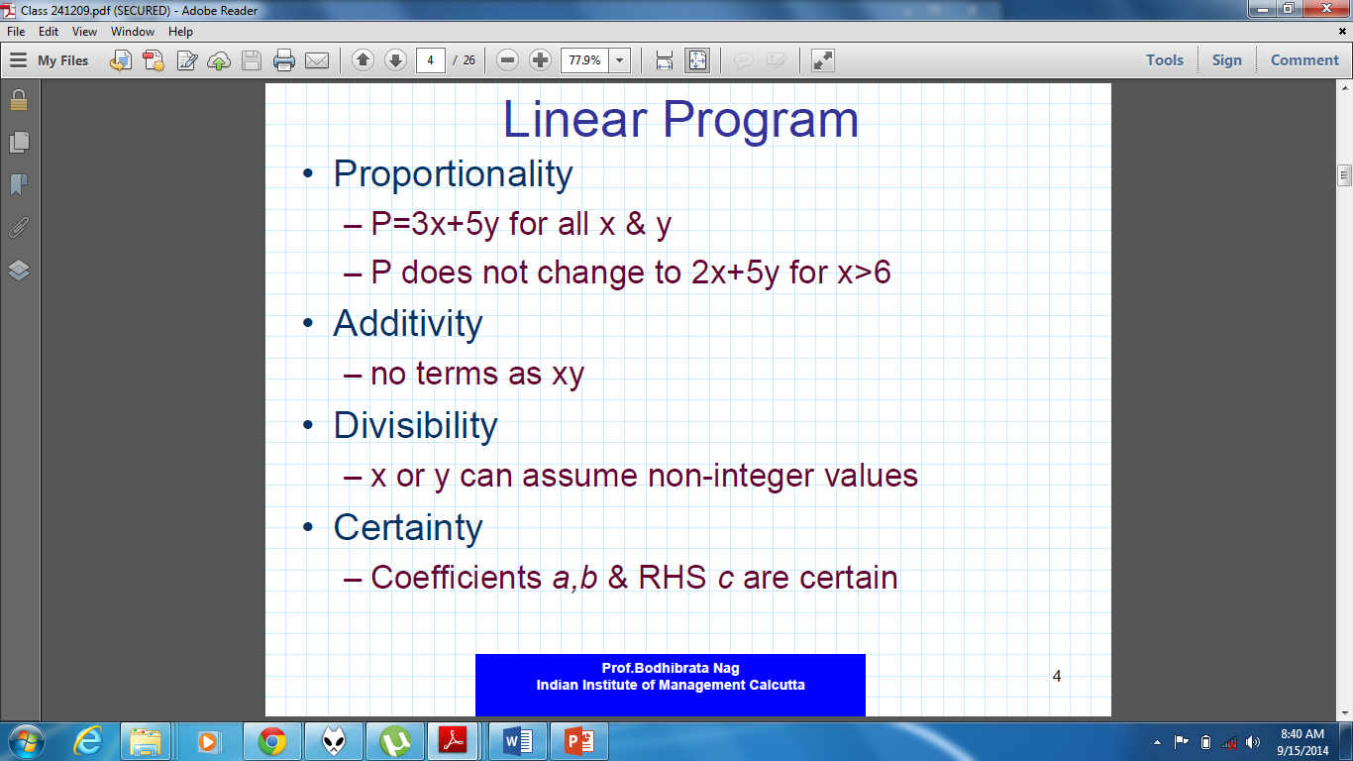

Slide 4
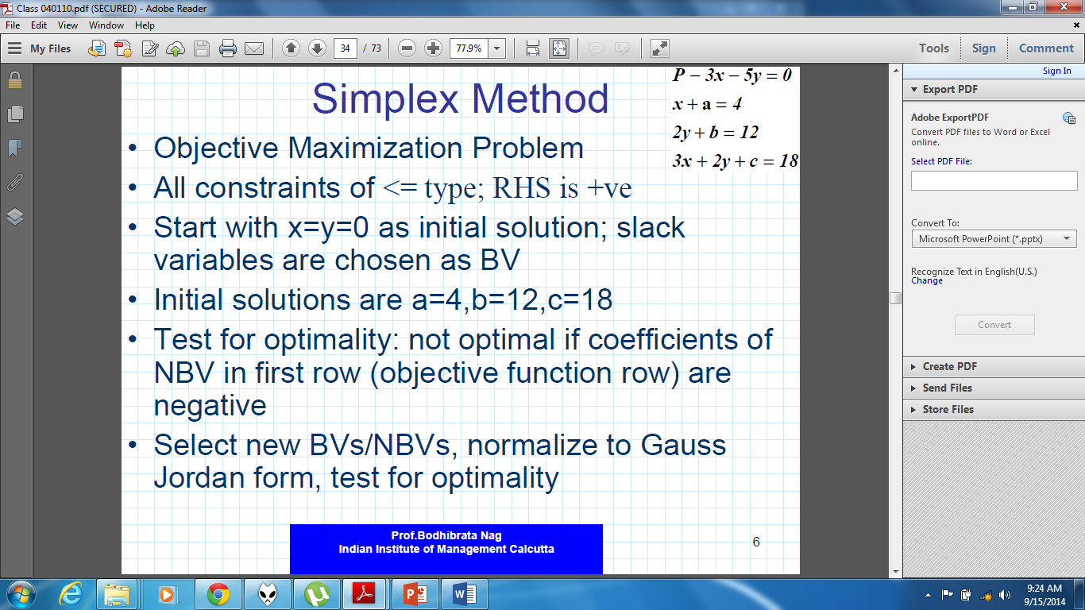

Slide 5
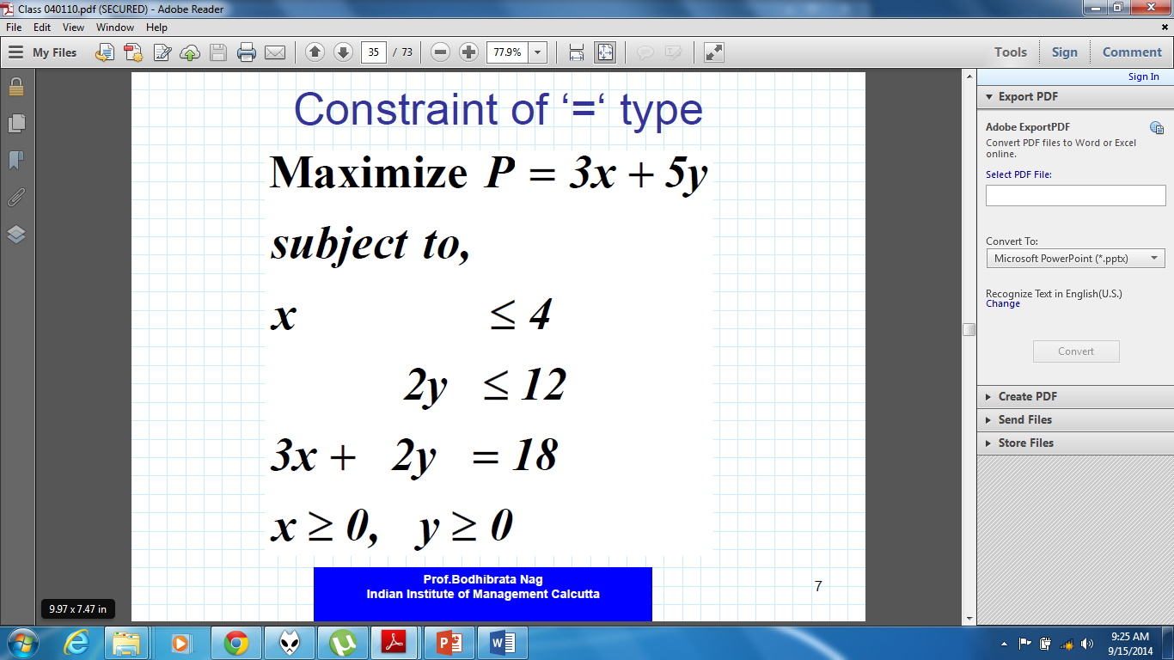

Slide 6
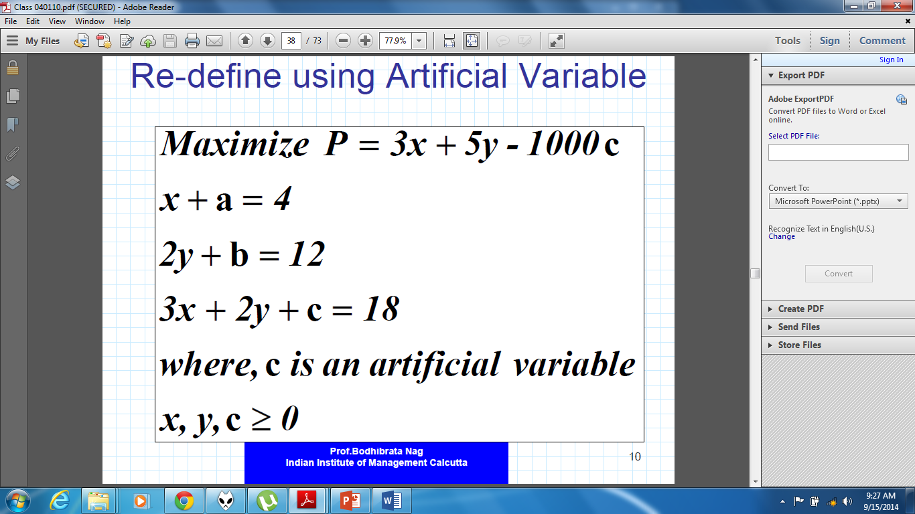

Slide 7
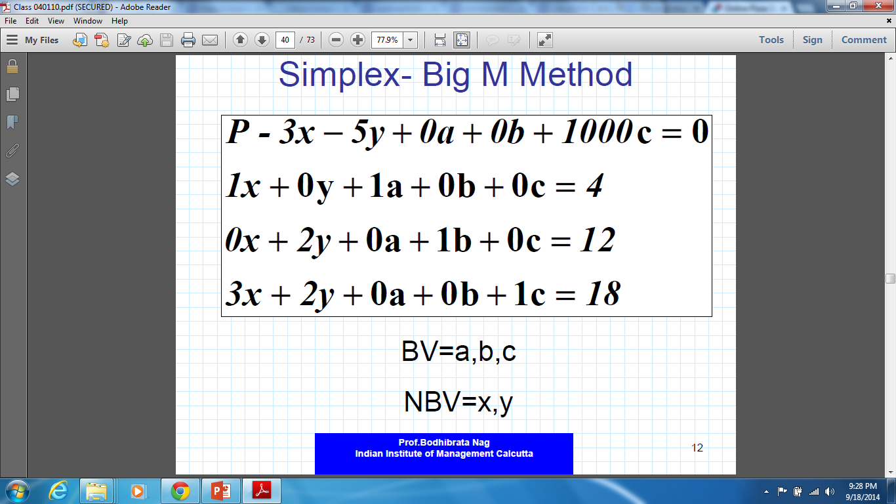

Slide 8
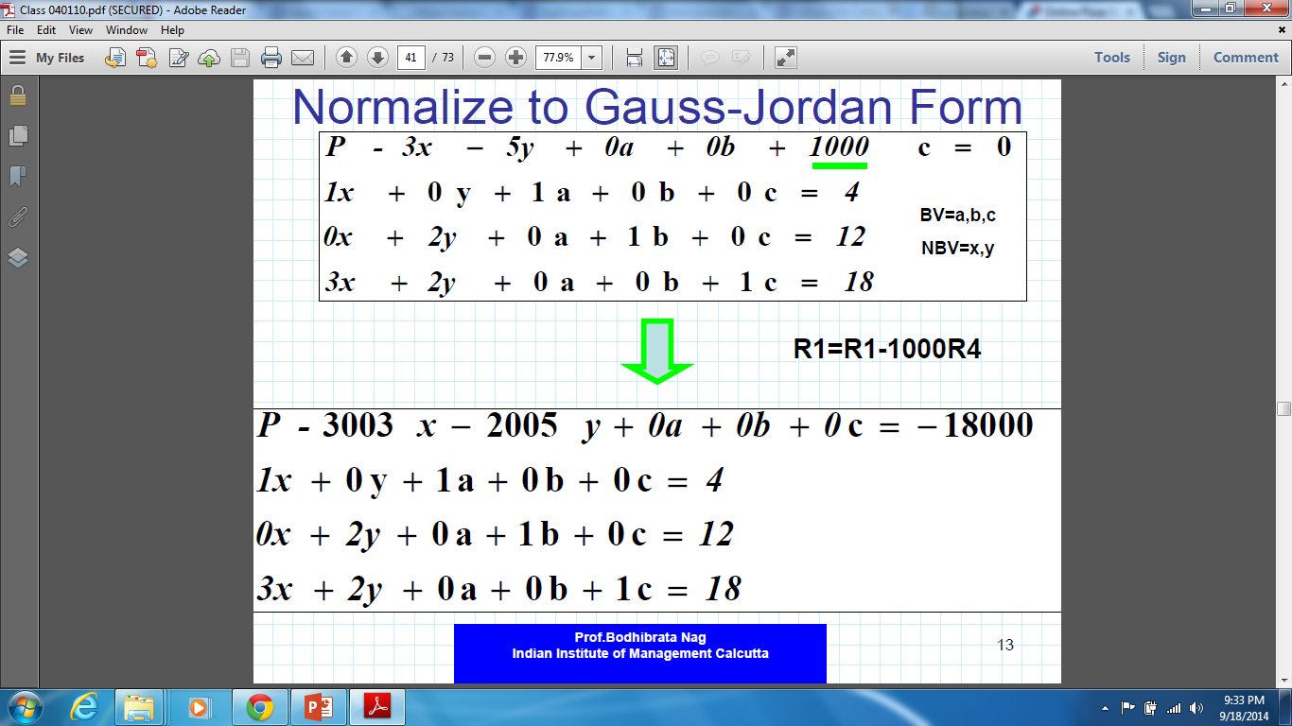

Slide 9
Entering And Leaving Basic Variable
The entering BV is the NBV which has the lowest negative coefficient in the topmost row of the simplex tableau
The Leaving BV is the BV with the lowest positive RHS value to entering BV coefficient ratio out of all BVs in the current simplex tableau
If a ratio is zero, if it is a positive zero (eg. 0/2), it is acceptable for leaving BV, but a negative zero (eg. 0/-2) is considered a negative ratio and not acceptable for leaving BV.
Using zero ratios raises the probability of looping, in which case take lowest positive non-zero ratio.
A Basic Variable has coeff. 1 for the constraint equation in which it acts as a BV, and 0 in all other constraints.

Slide 10
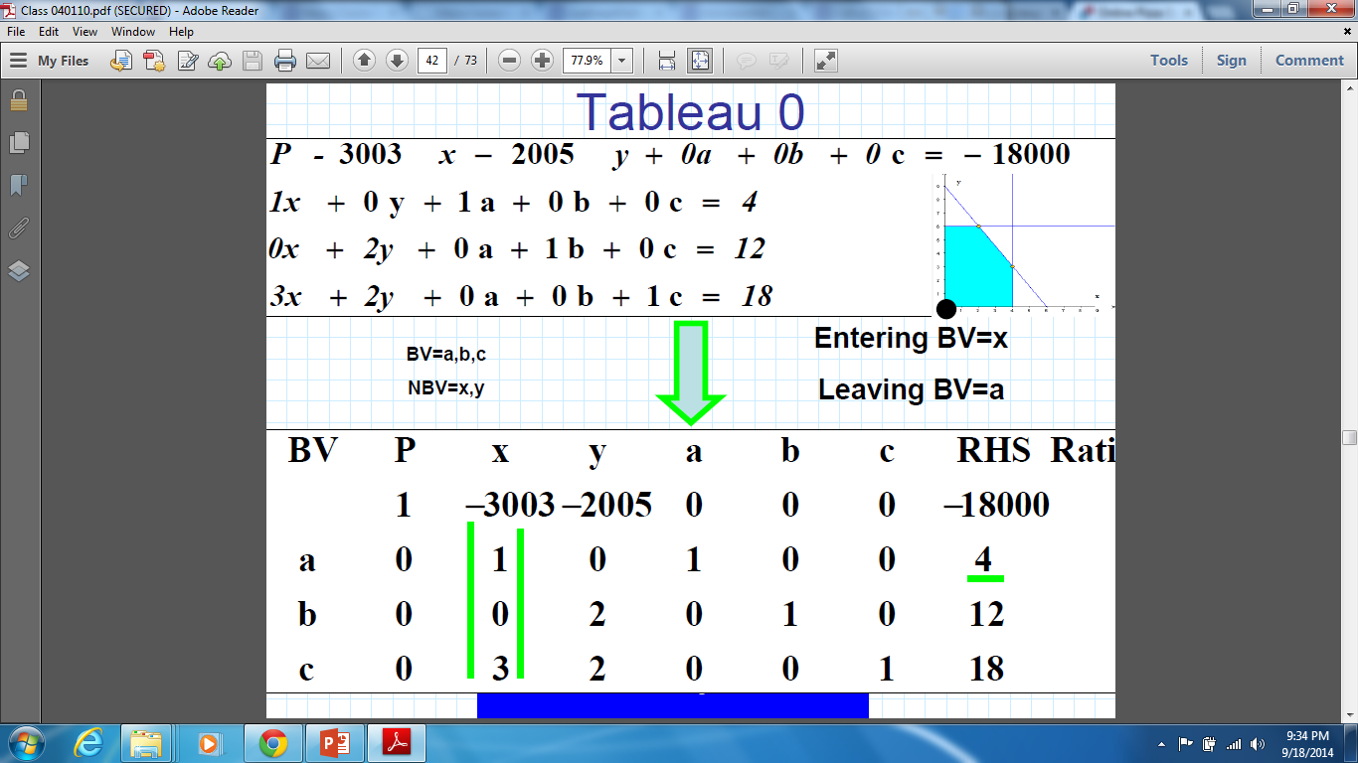

Slide 11
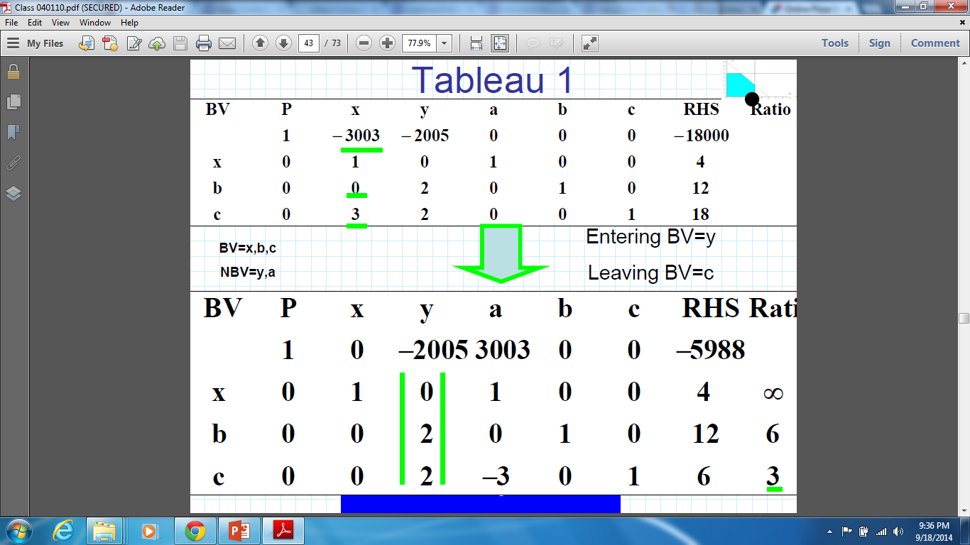

Slide 12
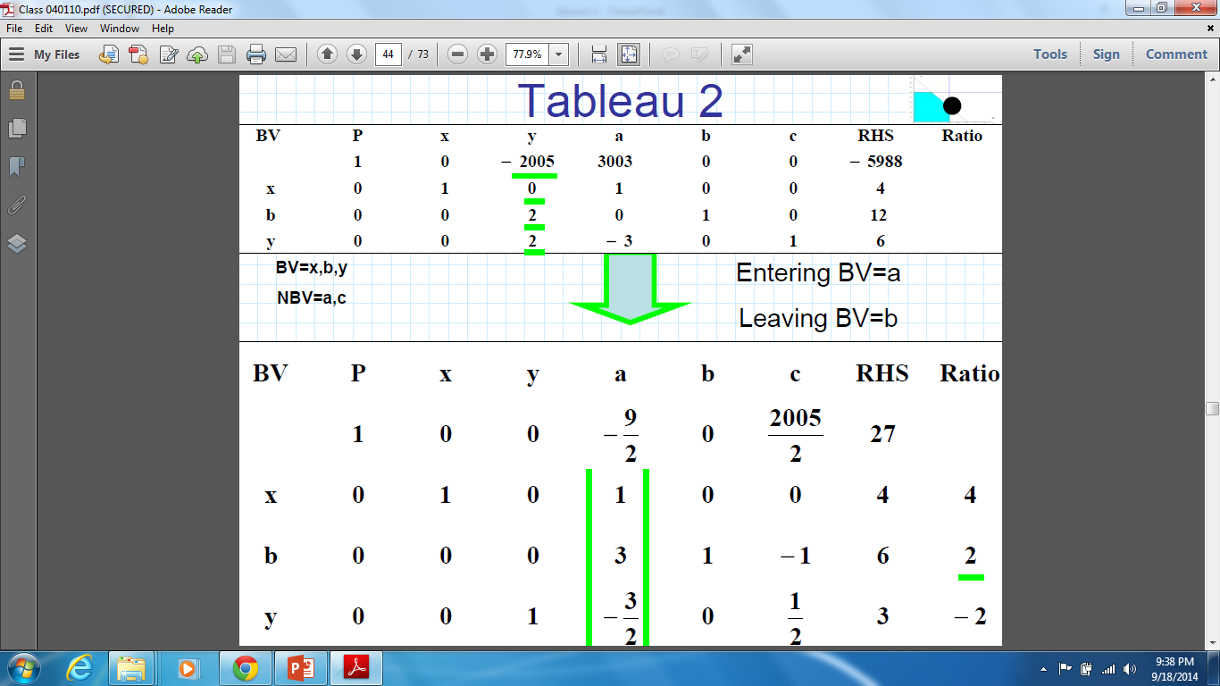

Slide 13
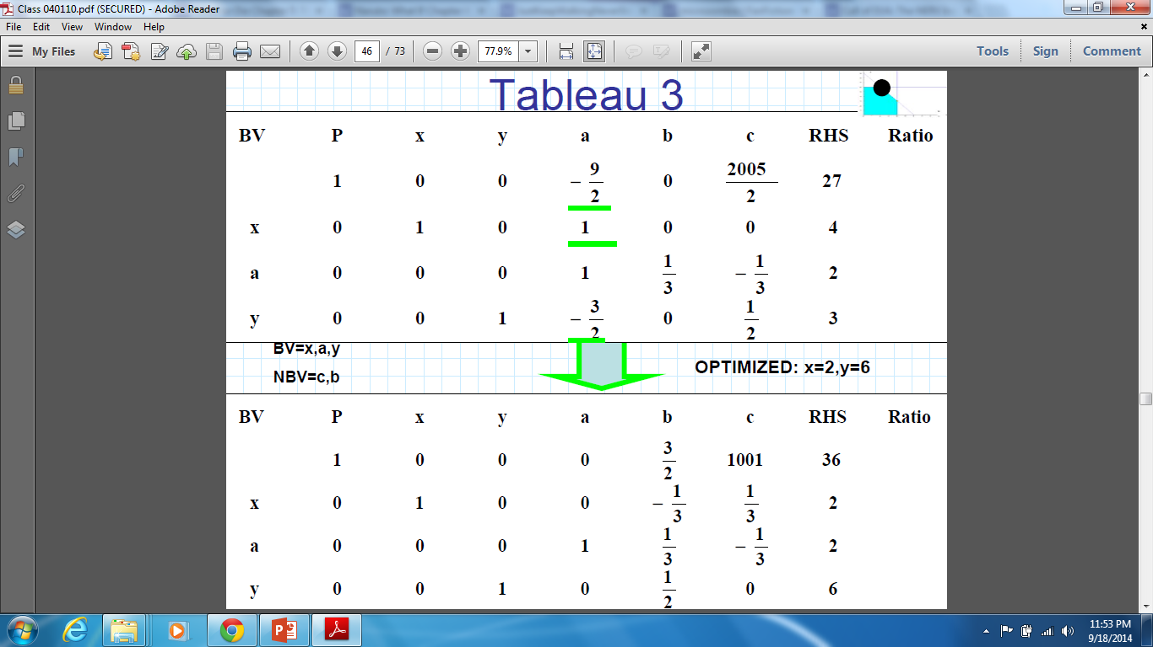

Slide 14
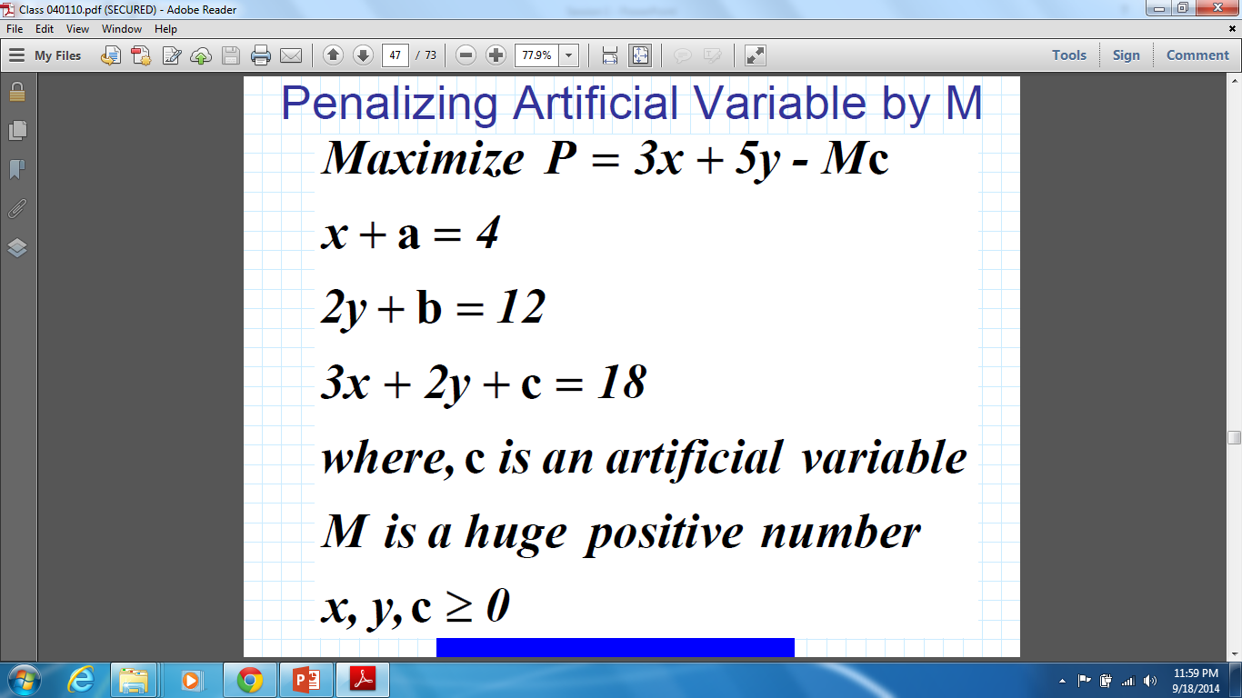

Slide 15
In any simplex table, when starting, the slack and artificial variables form the starting Basic Variables.

Slide 16
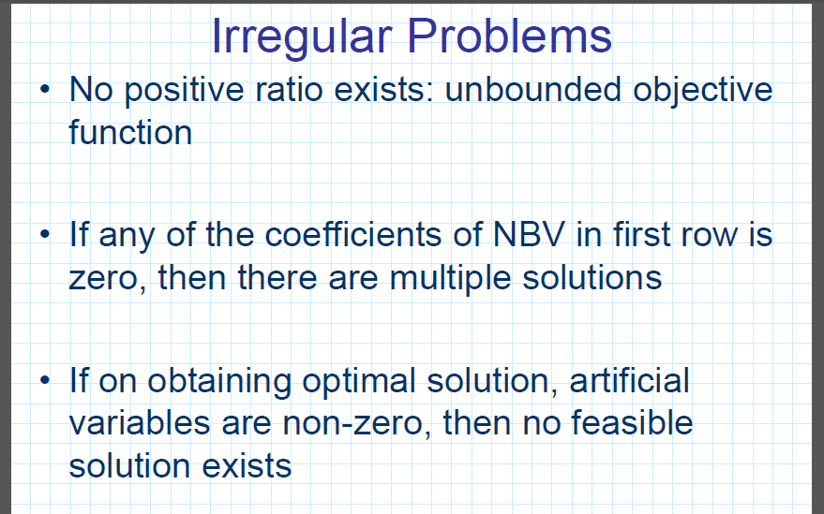

Slide 17
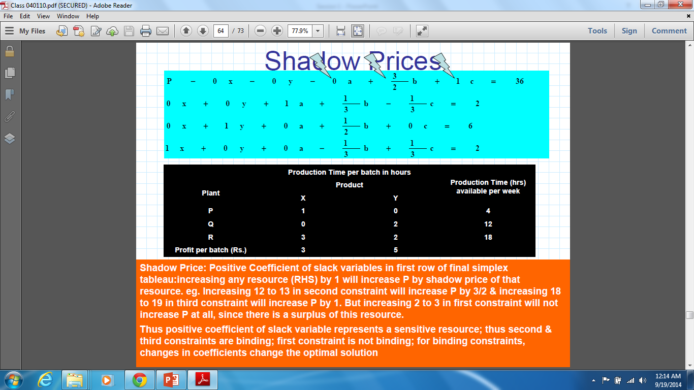

Slide 18
Solving LP problems in Excel
LP Problems can be solved in Excel using the Solver tool under the “Data” tab.
First, set up the linear programming equations and constraints using the information given in a problem, then implement those equations in Excel before solving them.
Excel Solver gives the option of using Simplex method to solve the problem.

Slide 19
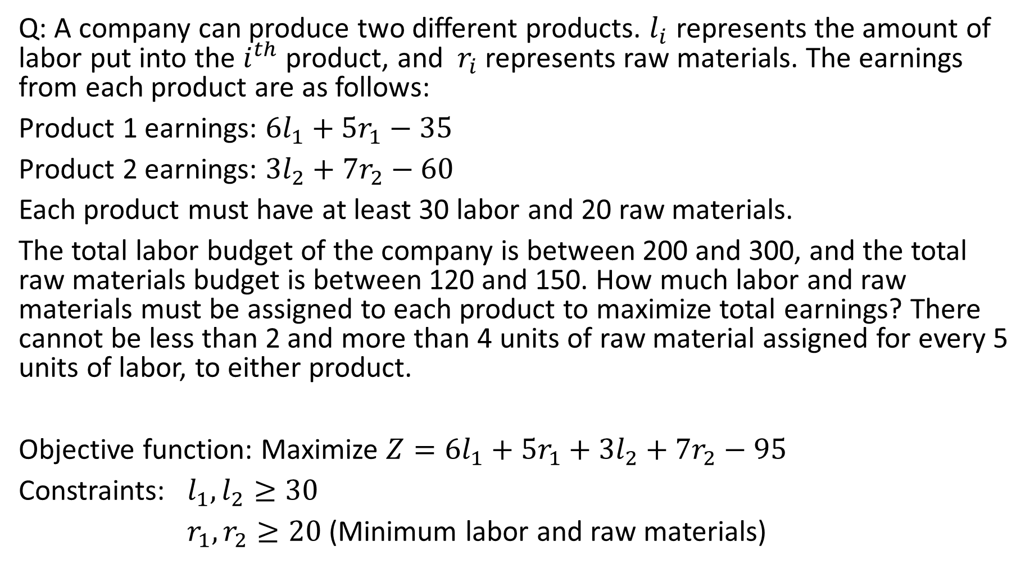
Q: A company can produce two different products. $l_{i}$ represents the amount of labor put into the $i^{th}$ product, and $r_{i}$ represents raw materials. The earnings from each product are as follows:
Product 1 earnings: $6l_{1}+{5r}_{1}−35$
Product 2 earnings: $3l_{2}+{7r}_{2}−60$
Each product must have at least 30 labor and 20 raw materials.
The total labor budget of the company is between 200 and 300, and the total raw materials budget is between 120 and 150. How much labor and raw materials must be assigned to each product to maximize total earnings? There cannot be less than 2 and more than 4 units of raw material assigned for every 5 units of labor, to either product.
Objective function: Maximize $Z=6l_{1}+{5r}_{1}+3l_{2}+{7r}_{2}−95$
Constraints: $l_{1},l_{2}≥30$
$r_{1},r_{2}≥20$ (Minimum labor and raw materials)

Slide 20

Labor and raw material budget constraints: $l_{1}+l_{2}≤300$
$l_{1}+l_{2}≥200$
$r_{1}+r_{2}≤150$
$r_{1}+r_{2}≥120$
$$\frac{r_{1}}{l_{1}}≥\frac{2}{5}→5r_{1}−{2l}_{1}≥0$$
$$5r_{2}−{2l}_{2}≥0$$
$$\frac{r_{1}}{l_{1}}≤\frac{4}{5}→5r_{1}−{4l}_{1}≤0$$
$$5r_{2}−{4l}_{2}≤0$$
Set up the problem in excel, solve using solver.

